Slide 1
Group 39 Project
Aabhash
Anik
Brandon
Daniel
Praj

Slide 2
Introduction
(problem that the software is aimed at solving)

Slide 3
Motivation
Explain the need for this software.
Why would FDM or anyone use this software

Slide 4
Proposed solution
How the features of the proposed software help solve said problems.

Slide 5
Roles
Explain the different users of the system

Slide 6
Competing Software
Chosen competing software and reasoning:
Scheduleit - This software caters to some of the biggest companies (such as: Facebook, Microsoft, Redbull, NHS, O2, BBC News etc...) in the world for their scheduling needs. This software gives us a framework of ideas we could incorporated in our software as most of the faults and features would have been phased out or the previously mentioned companies would have stopped using this software.
Bookinghound - This is a lesser used software in terms of the scale of this companies that use it, we can find more faults and features that don’t work as intended or missing functions and identify what our software won’t incorporate.

Slide 7
Competing Software
Pros and cons of scheduleit:
Pros: tried and tested by over 5,000 companies (including some of the biggest in the world), we can implement features from this software over to our software with minimal testing as scheduleit have already done it to ensure they keep their clients. This software keeps unlimited event history and an permanent audit trail which allows for records for clients and accountability for all employees, which is beneficial for FDM.
Cons: unlike the other competing software mentioned and also many other softwares, scheduleit doesn’t provide a larger number of features when more money is paid for the subscription; a global IT consultancy company such as FDM would be willing to pay more for additional features. Thankfully this disadvantage doesn't affect us due to the size of FDM; most of the faults have been phased out by scheduleit evident by it still being used by large companies.

Slide 8
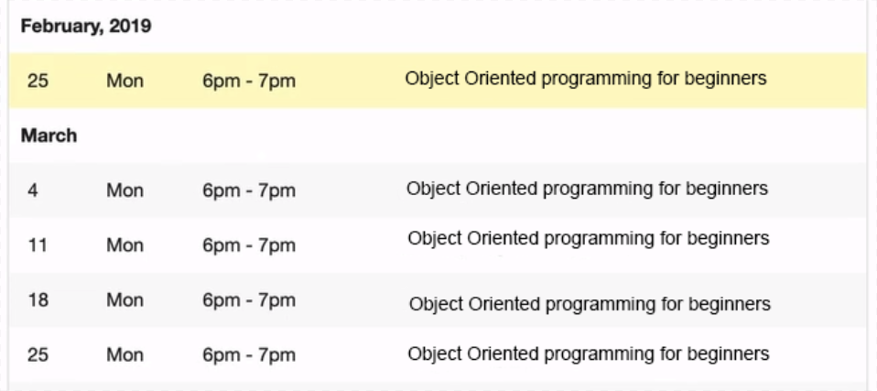
Competing Software
Pros of bookinghound:
Pros: this software has a feature which allows for scheduling multiple sessions for a particular course without having to repeat actions, reducing redundancies; for FDM which is a large company the quantity of bookings would be very large and reducing redundancies would make the amount of work done efficient. The notification sent out to users is customisable for each course or schedule booked so a change in location, duration or anything else could be implemented easily.

Slide 9
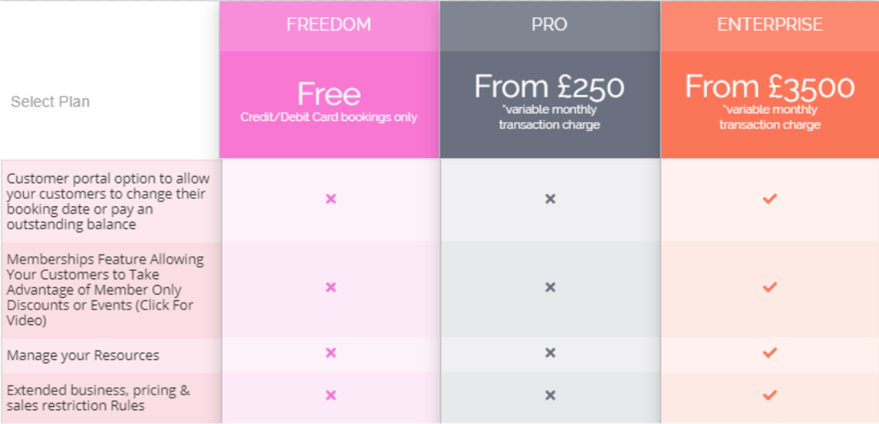
Competing Software
Cons of bookinghound:
Cons: bookinghound follow the industry standard of subscriptions as it allows for more features the more money you can pay:
the waiting list feature is not available for the first two tiers of subscription
You cannot get class passes for certain courses
Users also have to be in a certain tier of subscriber or they cannot change their booking date or pay an outstanding balance.
The business cannot track analytics and graphs of the scheduling reports unless they are the highest tier of subscriber

Slide 10
Q & A
Any questions?

